Slide 1
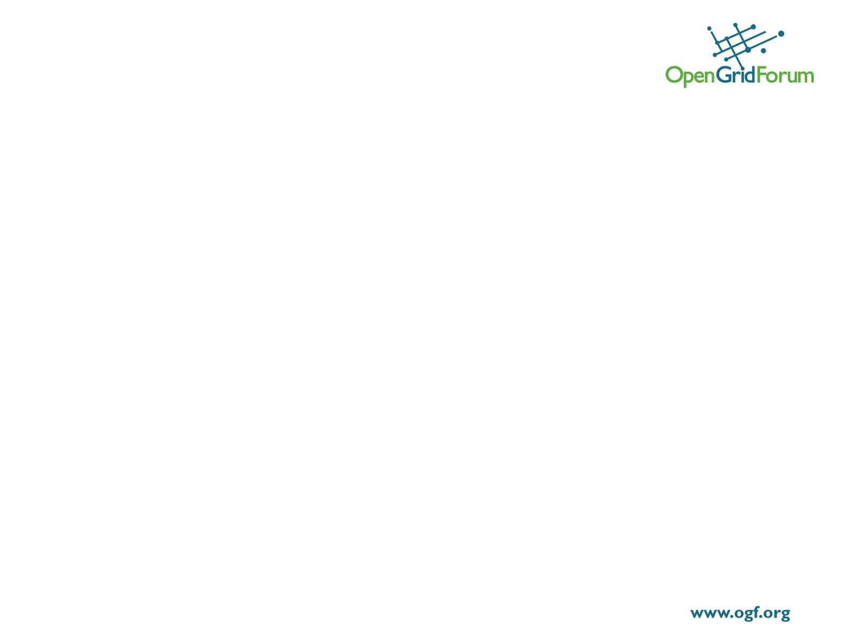
Agenda for Enterprise F2F
Review Existing structure/model
Discussion of what’s working and what’s not
  Is model broken and needs to be blown away?
  Or how do we improve the model?
Are we focused on the right target audience?
Do we have the right ammo?
What is the plan moving forward?
How do we execute to plan better and quicker
Open discussion on any other things that are working or not working and ways to improve

Slide 2
Existing Enterprise Function Model
CTO
Providing grid stuff via events, TLS ,etc
Customers
Enterprise
Adoption
Best
Practices
Networking/sharing
Grid
Experts
End
users
Vendors
Requirements and
standards

